Slide 1


Pelaksanaan Pembelajaran Teradun Gantian (PTG)
Sesi Perkongsian Amalan di UMP
Awanis Romli, PhD
Pengarah
Pusat Sumber Pengajaran & e-Pembelajaran
Universiti Malaysia Pahang
26600 Pahang
1

Slide 2

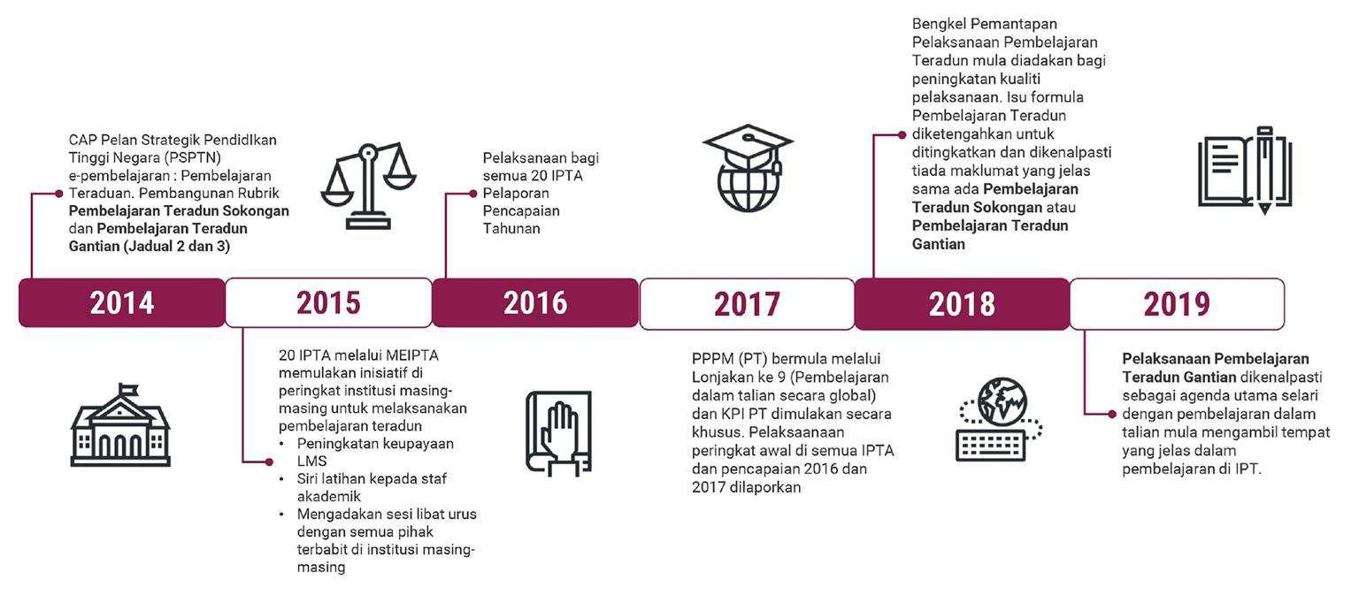
LATARBELAKANG
Implementation of Blended Learning by Malaysian Public Higher Learning Institutions
Sumber
Buku Garis Panduan Pelaksanaan Pembelajaran Teradun Gantian (Pembelajaran Dalam Talian)
Pelaksanaan Pembelajaran Teradun Gantian (PTG) di UMP
2020
2021
Pelaksanaan Pembelajaran Teradun Gantian (PTG) oleh semua universiti awam di Malaysia.
Substitute Blended Learning (SBL) / Pembelajaran Teradun Gantian (PTG)
Supportive Blended Learning (BL) / Pembelajaran Teradun Sokongan (PTS)
SLIDE | 2

Slide 3
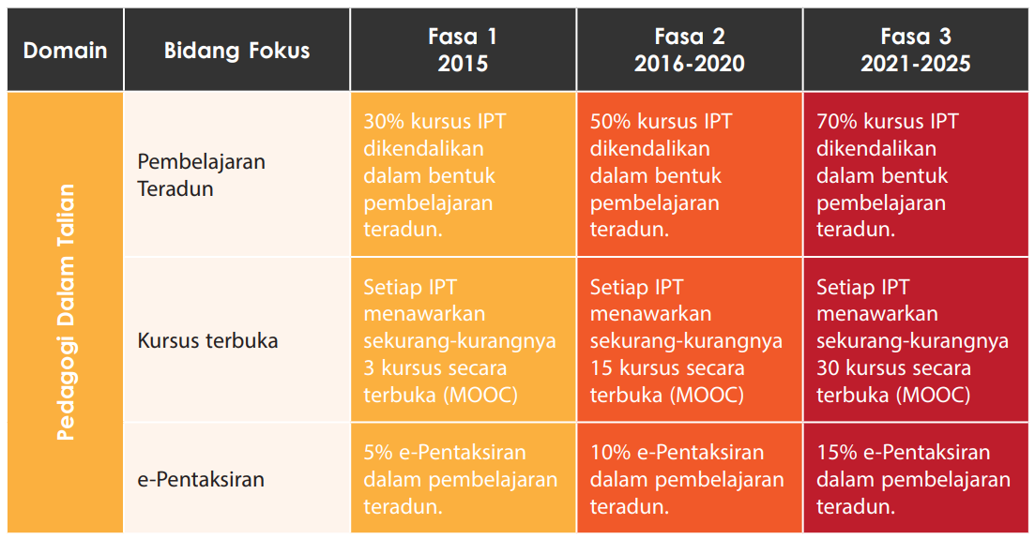
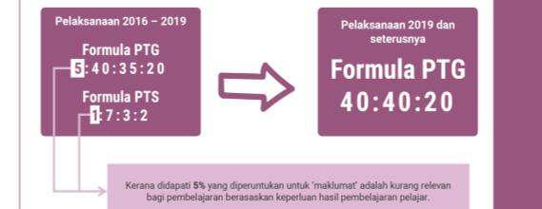
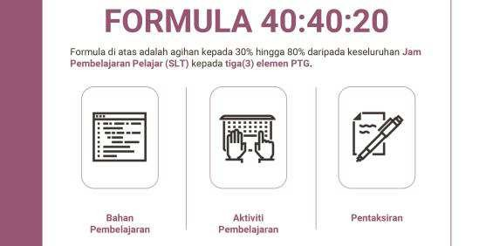
JUSTIFIKASI
Pelaksanaan PTG adalah selari dengan hasrat IPTA dalam Pendigitalan kampus serta menyokong agenda nasional yang digariskan di dalam DePAN 2.0. (m/s 26)
Pelaksanaan PTG akan meningkatkaan
kualiti penyampaian pembelajaran secara dalam talian dan ’micro-credentials’ pada masa akan datang
PTG mengarusperdanakan pendidikan
digital Negara, pendidikan fleksibel,
menyediakan pengajar dan pelajar bagi pendidikan abad ke-21 yang perlu mendepani transformasi Teknologi IR 4.0 dalam normal baharu
SLIDE | 3

Slide 4

PEMBELAJARAN TERADUN GANTIAN @UMP
AGENDA
Punca kuasa Pelaksanaan PTG
Penerapan PTG pada Rancangan Pembelajaran
Rekabentuk PTG pada KALAM
Pelaksanaan dan Pengiraan PTG dalam KALAM
Buku Garis Panduan Pelaksanaan Pembelajaran Teradun Gantian (Pembelajaran Dalam Talian)
1
4
SLIDE | 4

Slide 5


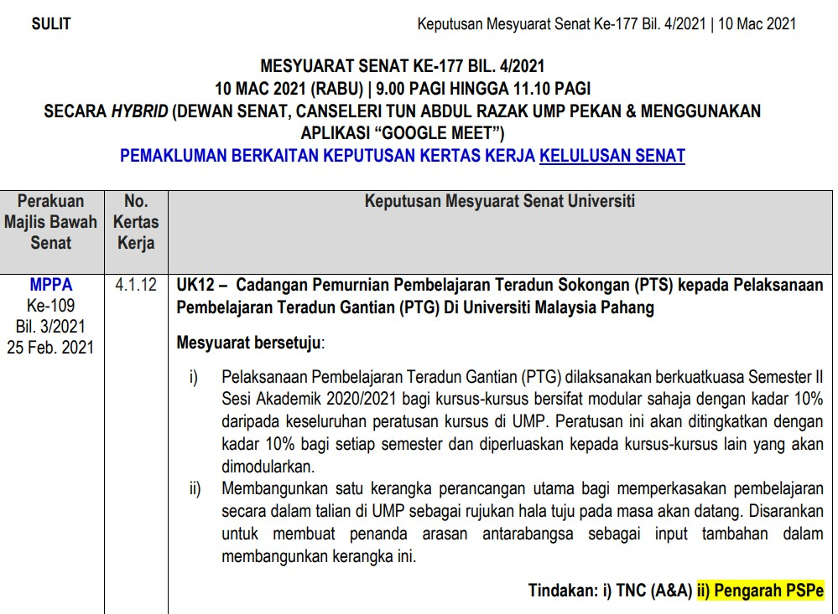
PUNCA KUASA
5
SLIDE | 5

Slide 6
Mengekalkan sasaran Pembelajaran Teradun UMP pada kadar 75% (1:7:3:2)
Sasaran Pembelajaran Teradun Gantian (PTG) UMP adalah dicadangkan pada kadar :
 | 10% |  | 30% |  | 50% |  | 70% |  | 90%
 | 2021 |  | 2022 |  | 2023 |  | 2024 |  | 2025
Model PTG 30%
Formula PTG
PELAKSANAAN
(30% - 50%)
(30% - 50%) (10% - 30%)
FASA 1
LM
LA
LS
(Pembudayaan)
Penerapan PTG didalam Rancangan Pengajaran (teaching plan) bagi kursus yang ditetapkan bermula Sem II 2020/2021.
PTG di UMP adalah dicadangkan untuk dijalankan
secara progresif dalam dua (2) fasa.
FASA 2
PTG dikecualikan bagi kursus yang bersifat dimana komponen praktikalnya adalah tinggi atau praktikal sepenuhnya.
(Pelaksanaan Penuh)
Pelaksanaan dan pemantauan PTG di platform KALAM bagi kursus yang ditetapkan pada Sem 1 2021/2022.

Slide 7



BLENDED LEARNING (SUBSTITUTE vs SUPPORTIVE)
4
OPERATIONAL DEFINITION:
Substitute Blended Learning
(PTG)
Supportive (Pembelajaran PTS)
Blended Learning –
Teradun Sokongan -
– SBL
SBL is an approach that combines online learning and face-to-face modes in the range of 30-80% of the Student Learning Time (SLT) based on the formula 40:40:20 with the combination of three main elements which are:
Supportive Blended Learning (PTS) is an approach that combines online learning and face-to-face modes in the range of 30-80% of the Student Learning Time
based on formula 1-7-3-2
1 Course info
7 Learning material
3 Learning Activity
2 Learning Assessment
Source
Learning Material
Learning Activity
Learning Assessment
Buku Garis Panduan Pelaksanaan Pembelajaran Teradun Gantian (Pembelajaran Dalam Talian)
https://tinyurl.com/SubstituteBlendedLearning
7

Slide 8

BLENDED LEARNING (SUBSTITUTE vs SUPPORTIVE)
4
OPERATIONAL DEFINITION:
Substitute Blended Learning
(PTG)
Supportive (Pembelajaran PTS)
Blended Learning –
Teradun Sokongan -
– SBL
SBL is an approach that combines online learning and face-to-face modes in the range of 30-80% of the Student Learning Time (SLT) based on the formula 40:40:20 with the combination of three main elements which are:
Supportive Blended Learning (PTS) is an approach that combines online learning and face-to-face modes in the range of 30-80% of the Student Learning Time
based on formula 1-7-3-2
1 Course info
7 Learning material
3 Learning Activity
2 Learning Assessment
Source
Learning Material
Learning Activity
Learning Assessment
Buku Garis Panduan Pelaksanaan Pembelajaran Teradun Gantian (Pembelajaran Dalam Talian)
https://tinyurl.com/SubstituteBlendedLearning
8

Slide 9



PTS vs PTG
SOKONGAN / SUPPORTIVE
Physical in-person- real time
Virtual (teleconferencing)- real time
Replace (in-person/virtual) – real time, outside original schedule
GANTIAN / SUBSTITUTE
Real time face-to-face (physical in-person / virtual via teleconferencing)
Self-paced, anytime, anywhere

Slide 10






WHY SUBSTITUTE BLENDED LEARNING
LECTURER
Continuity in Instruction due to absence of lecturer (public holidays, conferences, administrative work, personal matters, etc)
Embracing Education 2.0 in the context of IR 4.0 and the new normal
Embracing Digitalization of UMP and National Education Digitalisation
STUDENTS
Continuity in learning progress
Flexible education – anytime, any place and any how
Develop self-regulated students (autonomous)
Matching learner’s learning style with Education 2.0 and IR 4.0 in the new normal

Slide 11










FORMULA
40 : 40 : 20
SBL based on Student Learning Time (SLT)
SLT for 3 credit hours 120 hours
Conventional TnL : 70% x 120 hours =
84 hours
SUBSTITUTE BL : 30% x 120 hours =
36 hours
NEW
Lecture
Tutorial
Laboratory
Self Assessment Learning
Material
40%
Activity
40%
Assessment
20%
Guided/non guided
11

Slide 12
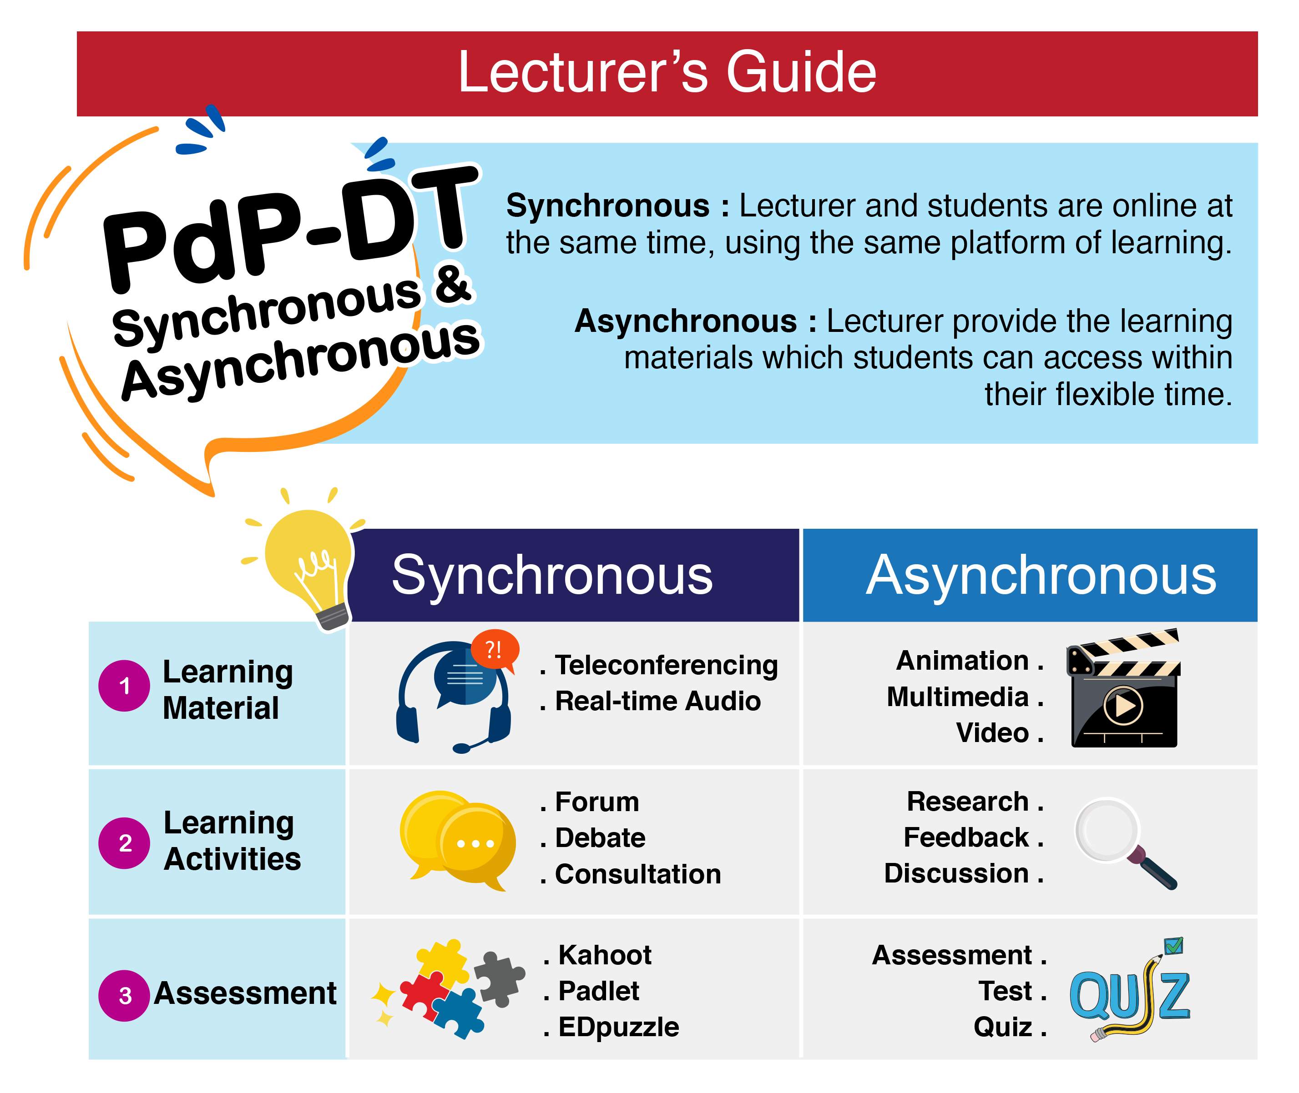
HOW TO DESIGN SUBSTITUTE BLENDED LEARNING
2
Substitute at 30% for a course
F2F Virtual
Substitute
SUBSTITUTE BLENDED LEARNING
Online platform (sync or async)

Slide 13
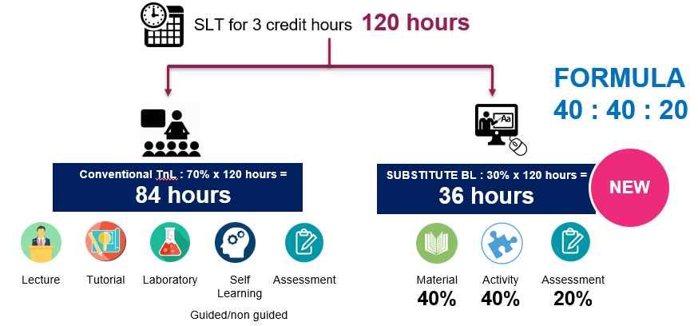
Online Delivery
F2F Virtual
Substitute
SLT
40%
40%
20%

Slide 14




30% SBL hour → Week?
  SUBSTITUTE BL : 30% x 120 hours = 36 hours
Material
40 =
40% X 36 = 14 hrs
Activity
40 =
40% X 36 = 14 hrs
Assessment
20 =
40% X 36 = 8 hrs
Online
F2F class
1 semester = 14 weeks (Teaching and Learning)
SBL Hours → 14 Weeks?
36 / 120 * 14 = 4.2 (4 weeks)
SBL 4 weeks with 30% SBL = 4 weeks

Slide 15
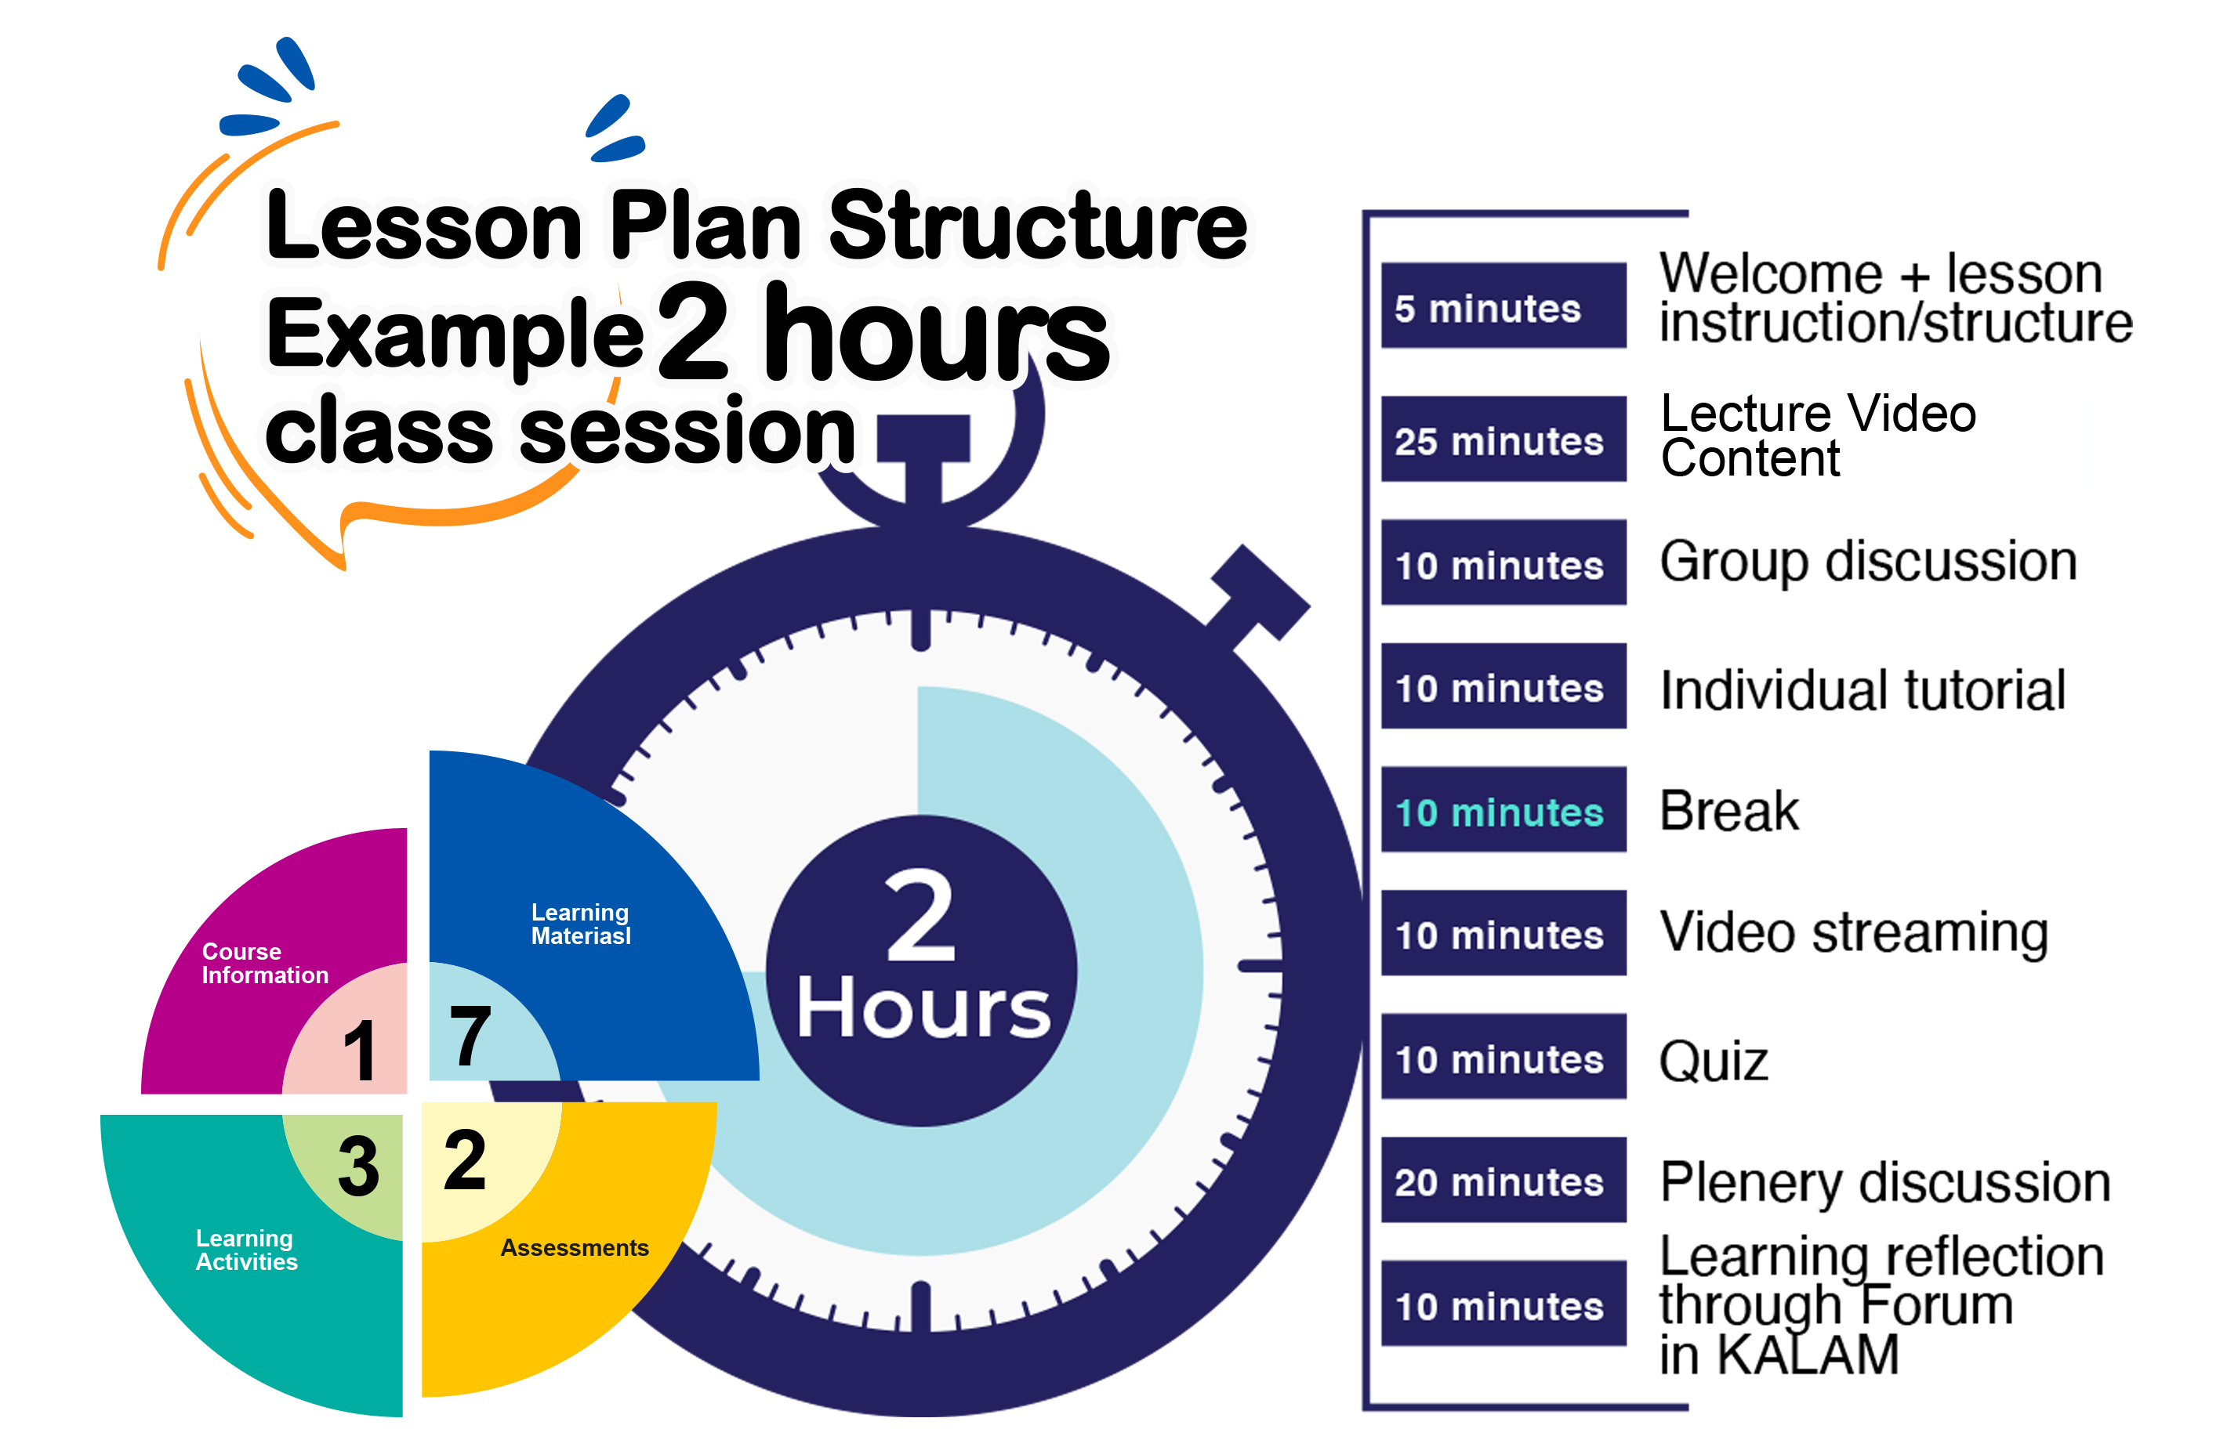
2
HOW TO DESIGN SUBSTITUTE BLENDED LEARNING
Online
F2F class

Slide 16

Asynchronous Online Remote Learning
30% SBL = 4 weeks
Material 40% = 14 hours
Content video developed by SME
Podcast
Screencast
Narrated presentation
Animation/Web 2.0 tools : powtoon, prezi etc
Simulation (VR/AR/MR)
Interactive content. Example: ThingLink
Interview video
Practical/laboratory video
Industry visit video
Activity 40% = 14 hours
Assessment 20% = 8 hours
Web 2.0 tools:
Online Assessment:
Kahoot
Padlet
edPuzzle
Collaborative learning
Lab tutorial
Forum, chatting in KALAM
Quiz
Assignment
Hands on Test
Peer evaluation
ENGAGEMENT? (Y/N)
16

Slide 17









IMPLEMENTATION OF SUBSTITUTE BLENDED LEARNING (SBL)
4
The face to face contact sessions between the learners and instructor can be conducted in various modalities which may include or
(COPPA:ODL)
FACE-TO-FACE MODE
Weeks
Delivery
1
Face-to-face physical class – Conventional
physical
virtual sessions
2
Face-to-face online class (Synchronous)
Flexible with any changes or
disruption in T&L
3
Non-face-to-face (Asynchronous) -
SUBSTITUTE
Flexible “Anytime, Anywhere, Anyway, Anyhow”
Self Directed Learning with interactive learning instruction
4
5
Student’s attendance record is replaced by learning participation and achievement
Student’s attendance record is replaced by learning participation and achievement
6
Learning materials, activities and assessment for SBL need to be documented in KALAM
12

Slide 18

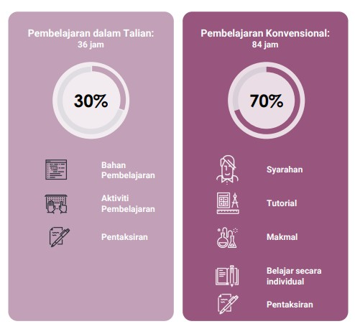


UMP’s SBL IMPLEMENTATION- 30% SBL
In the context of Hybrid Learning (Physical + Online)
Online Learning
F2F – Physical
Material
Lecture
Activity
Tutorial
Assessment
Lab
Self learning
Substitute 4 weeks with Asynchronous Online Remote Learning
Assessment
30% SBL = 4 weeks
Asynchronous
Synchronous
In the context of Online Remote Learning
37

Slide 19
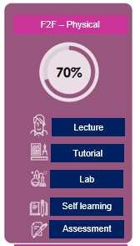






Implementation of 30% Online Learning and 70% Physical in Hybrid Learning
Online Learning
Content Video (SME) = 6 hours
Material 40%
Weeks: 3, 4, 5, 6
14 hours
Practical/laboratory video = 4 hours
Collaborative learning = 4 hours
Activity 40%
Lab tutorial = 8 hours
14 hours
Weeks: 3, 4, 5, 6
Collaborative learning = 6 hours
Assessment 20%
8 hours
Assignment = 8 hours (preparation time)
Weeks: 5, 6, 7, 8
Weeks: 1, 2, 7, 8, 9, 10,
11, 12, 13, 14
Total SLT 30% = 36 hours

Slide 20

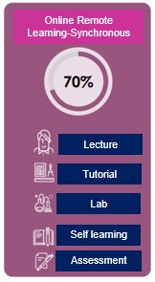
Implementation of 50% SBL in Online Remote Learning
Online Class + self learning = 24 hours
Weeks: 1, 2, 10, 11,
12, 13, 14
Content Video (SME) = 9 hours
Material
40% x 60 hours
24 hours
Practical/laboratory video = 6 hours
Weeks: 3, 4, 5, 6, 7, 8, 9
Collaborative learning = 8 hours
50%
Online Lab / Tutorial = 24 hours
Weeks: 1, 2, 10, 11,
12, 13, 14
Activity
40% x 60 hours
24 hours
Lab tutorial = 16 hours
Weeks: 3, 4, 5, 6, 7, 8, 9
Collaborative learning = 8 hours
Assessment 20% x 60 hours
Weeks: 6, 10, 11
Online exams (HOT + midterm test + self learning) = 8 hours
Assignment (5%) = 4 hours
12 hours
Weeks: 5, 6, 7, 8, 9, 10
Weeks: 1, 2, 10, 11,
12, 13, 14
Total SBL 50% = 60 hours
Total SLT Online Remote Learning = 120 hours SBL = (7/14) @ (60/120 = 50%)

Slide 21
SBL simulation for 2 credit hours (80 hours)
Elements on Online Learning | Weightage | SBL 30% | SBL 40% | SBL 50%
 |  | Total SLT | Total SLT | Total SLT
Material | 40% | 10 | 13 | 16
Activity | 40% | 10 | 13 | 16
Assessment | 20% | 4 | 6 | 8
Total hours for SBL |  | 24 (4 weeks) | 32 (5-6 weeks) | 40 (7 weeks)
Total hours for Conventional |  | 56 (10 weeks) | 48 (8-9 weeks) | 40 (7 weeks)
21

Slide 22
SBL simulation for 3 credit hours (120 hours)
Elements on Online Learning | Weightage | SBL 30% | SBL 40% | SBL 50%
 |  | Total SLT | Total SLT | Total SLT
Material | 40% | 14 | 19 | 24
Activity | 40% | 14 | 19 | 24
Assessment | 20% | 8 | 10 | 12
Total hours for SBL |  | 36 (4 weeks) | 48 (5-6 weeks) | 60 (7 weeks)
Total hours for Conventional |  | 84 (10 weeks) | 72 (8-9 weeks) | 60 (7 weeks)
22

Slide 23
SBL simulation for 4 credit hours (160 hours)
Elements on Online Learning | Weightage | SBL 30% | SBL 40% | SBL 50%
 |  | Total SLT | Total SLT | Total SLT
Material | 40% | 19 | 26 | 32
Activity | 40% | 19 | 26 | 32
Assessment | 20% | 10 | 12 | 16
Total hours for SBL |  | 48 (4 weeks) | 64 (5-6 weeks) | 80 (7 weeks)
Total hours for Conventional |  | 112 (10 weeks) | 96 (8-9 weeks) | 80 (7 weeks)
23

Slide 24
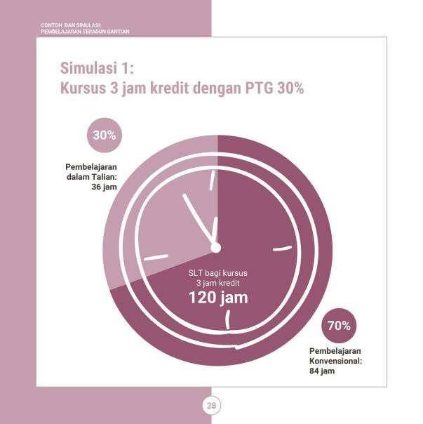
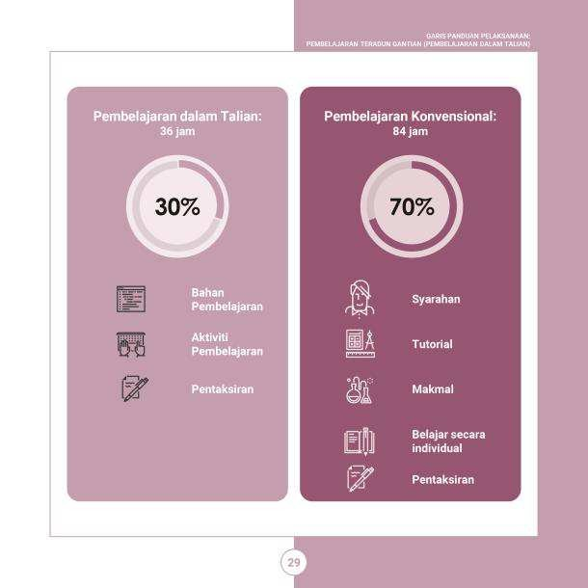
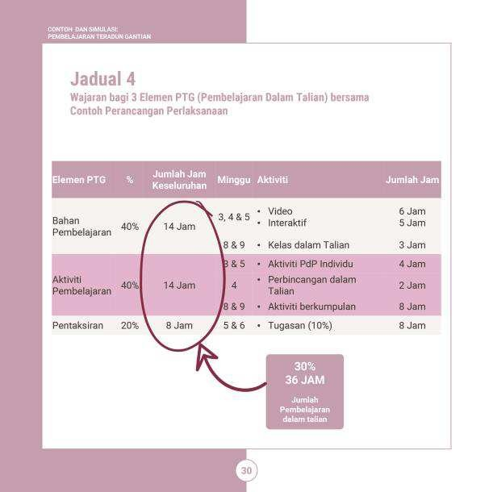
Simulasi Pembelajaran Teradun Gantian Mengikut Kadar Peratusan Gantian
Simulasi : PTG 30%
Buku Garis Panduan Pelaksanaan Pembelajaran Teradun Gantian (Pembelajaran Dalam Talian)

Slide 25

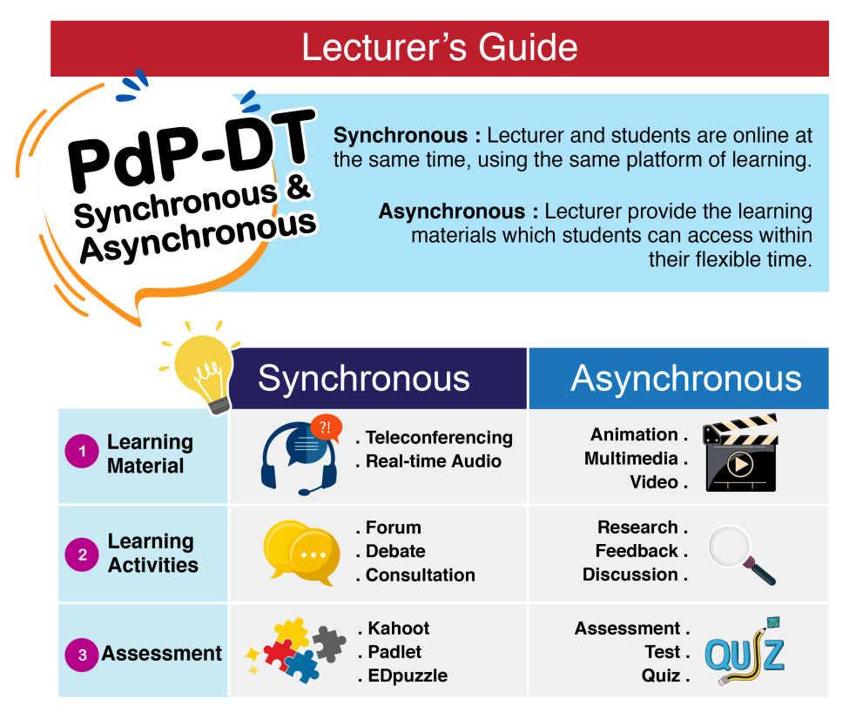


Contoh : Panduan bagi menganggarkan jam pembelajaran
pelajar (SLT) dengan bahan PdP secara dalam talian
SLT
40%
40%
20%

Slide 26
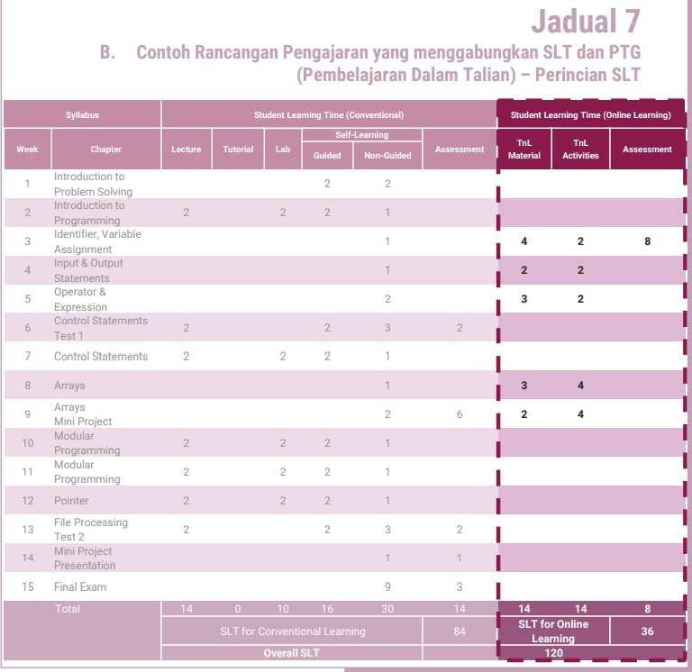
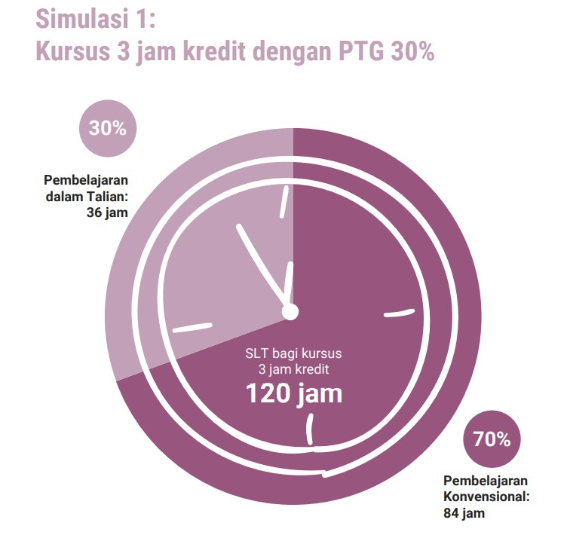
PENERAPAN PTG PADA RANCANGAN PENGAJARAN
2

Slide 27


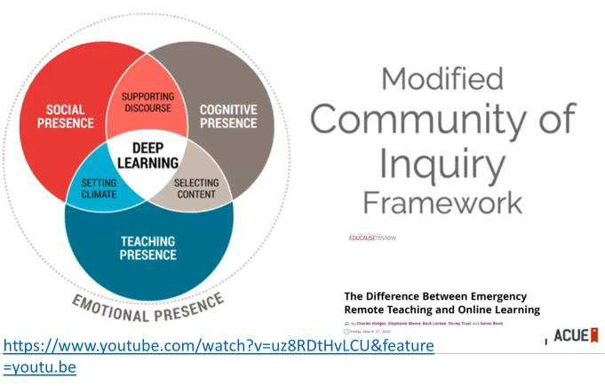
3
REKA BENTUK PTG

Slide 28

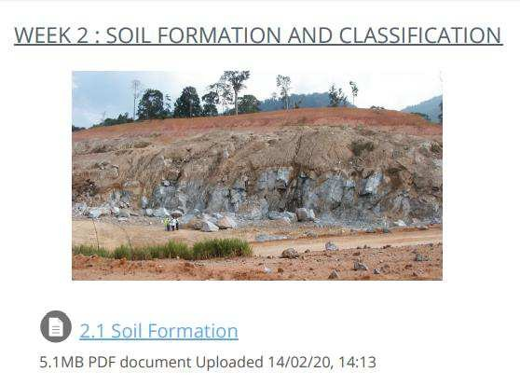
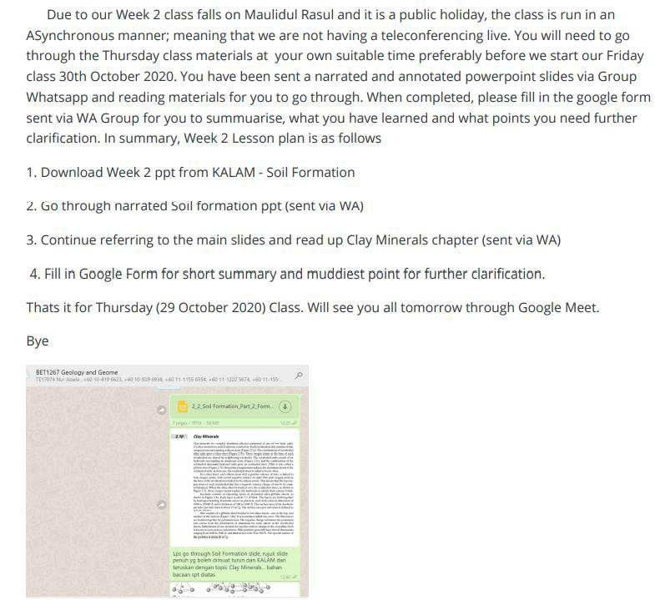
REKABENTUK PTG DALAM KALAM
2
SUPPORTIVE BL
SUBSTITUTE EMERGENCY REMOTE TEACHING
LM (3.6hrs)
LA (3.6hrs)
LS (1.8hrs)
SUBSTITUTE BL - ASYNCHRONOUS REMOTE
Learning Materials (3.6hrs), Learning Activities (3.6 hrs)
Learning Assessment (1.8 hrs) = SLT (9hrs)
FACE TO FACE – PHYSICAL/VIRTUAL
Lecture (3hrs) ILT (6hrs) = SLT (9hrs)

Slide 29
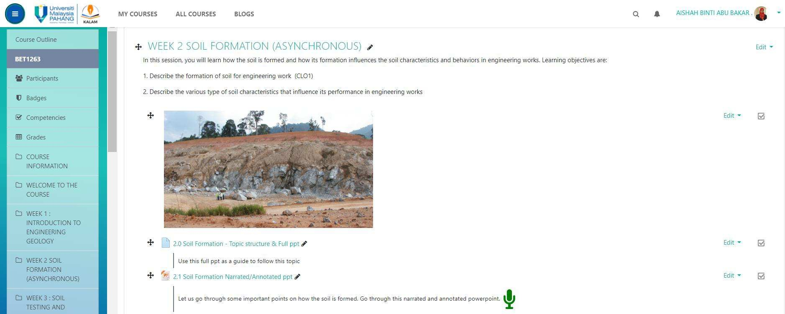
REKABENTUK PTG DALAM KALAM
3
LM (3.6hrs) | LA (3.6 hrs) | Asmnt (1.8hrs) = SLT (9 hrs) 40% | 40% | 20% online SLT

Slide 30
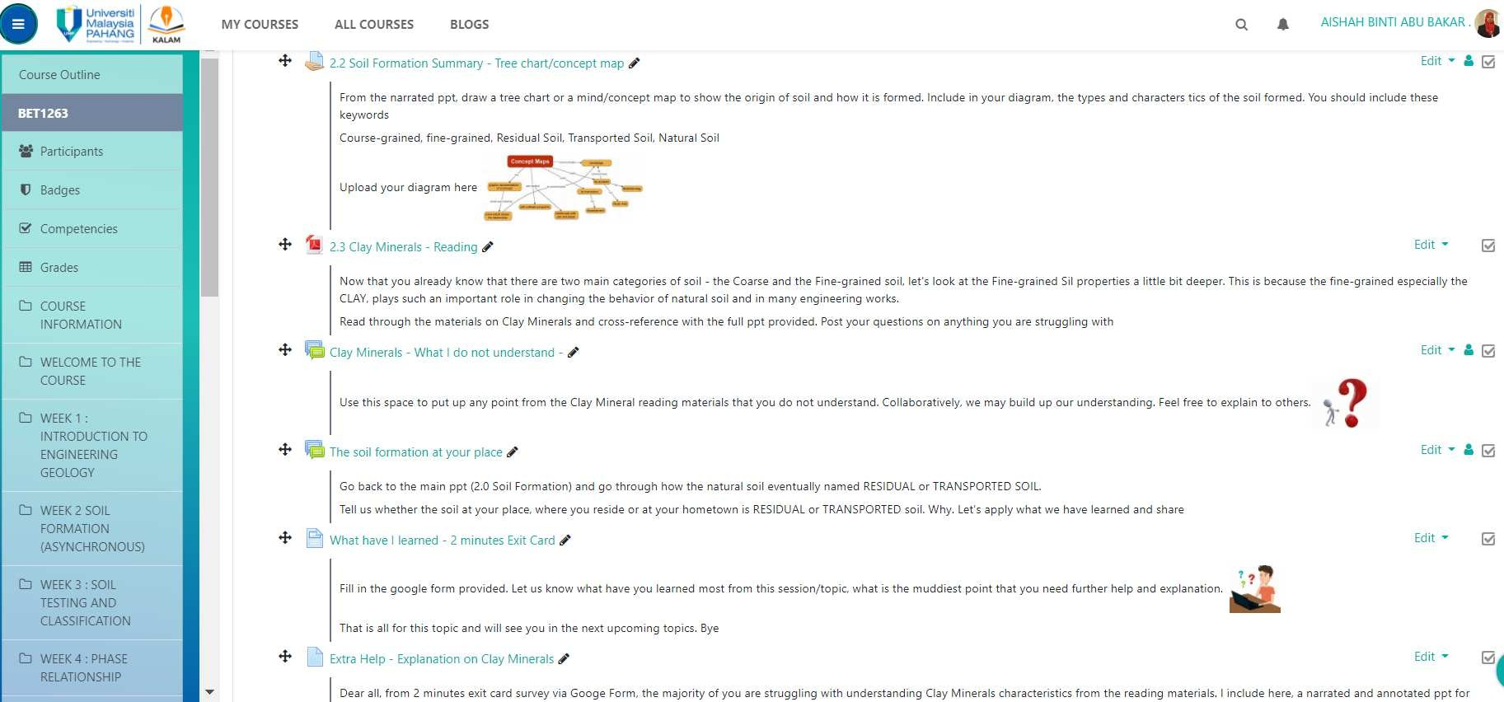
3
LM (3.6hrs) | LA (3.6 hrs) | Asmnt (1.8hrs) = SLT (9 hrs)
40% | 40% | 20% online SLT
SLIDE | 26

Slide 31
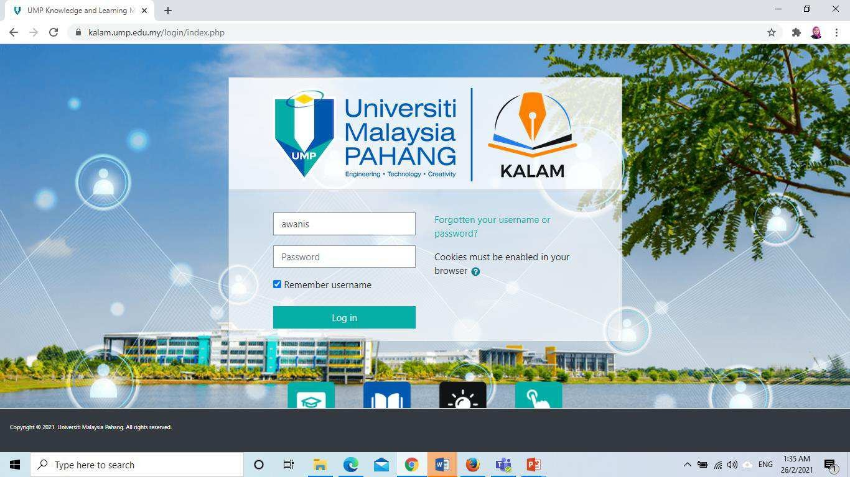
SBL Declaration through KALAM

Slide 32
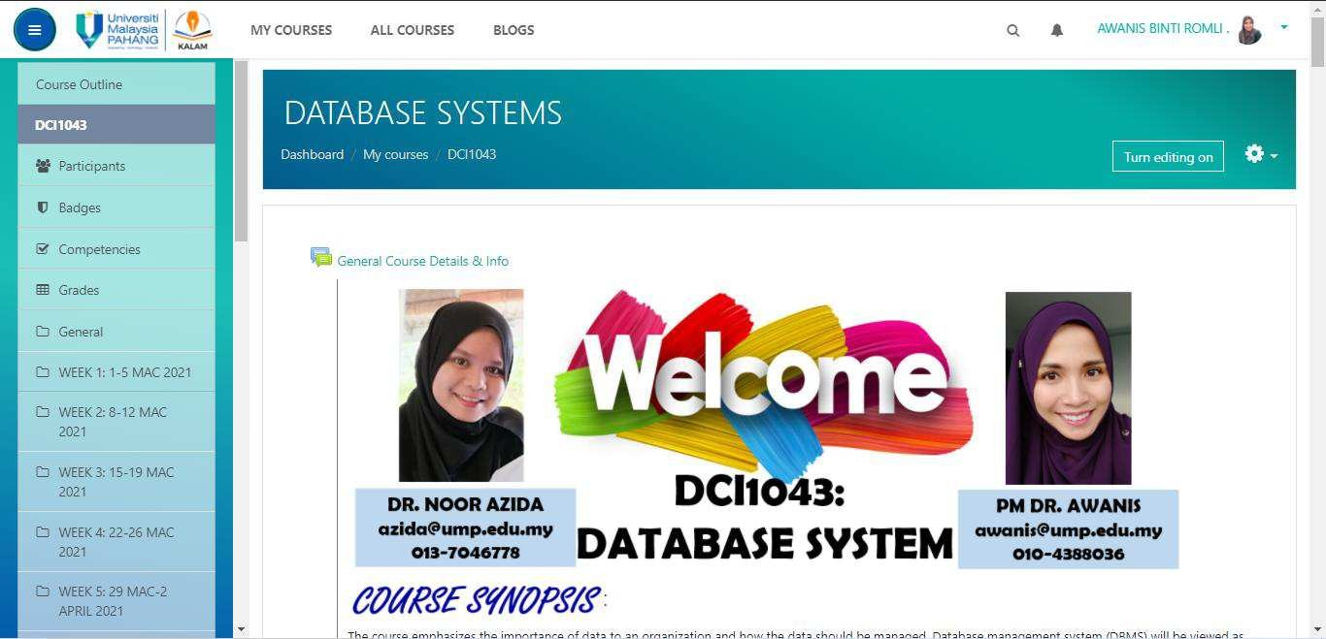
SBL Declaration for Learning Material (LM)
1. Click “Turn editing on”

Slide 33
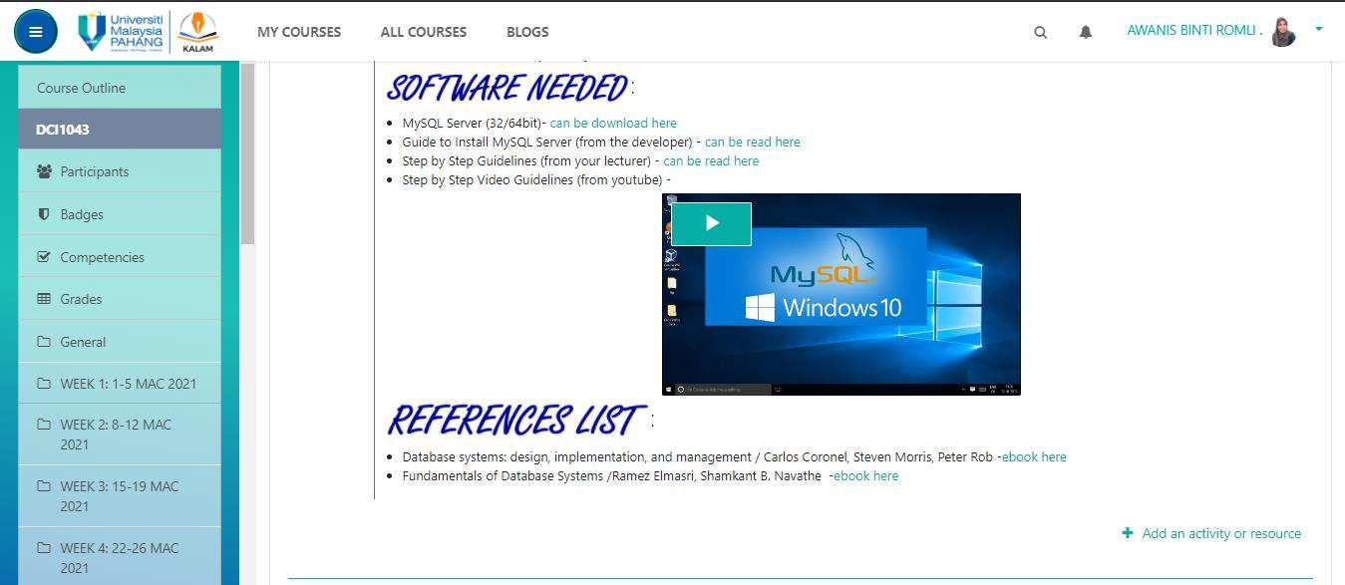
2. Click “Add an activity or
resources

Slide 34
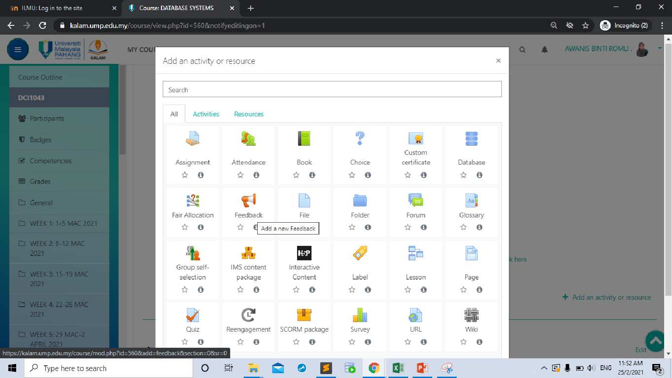
3. Select the activity or resource for example, “File”

Slide 35
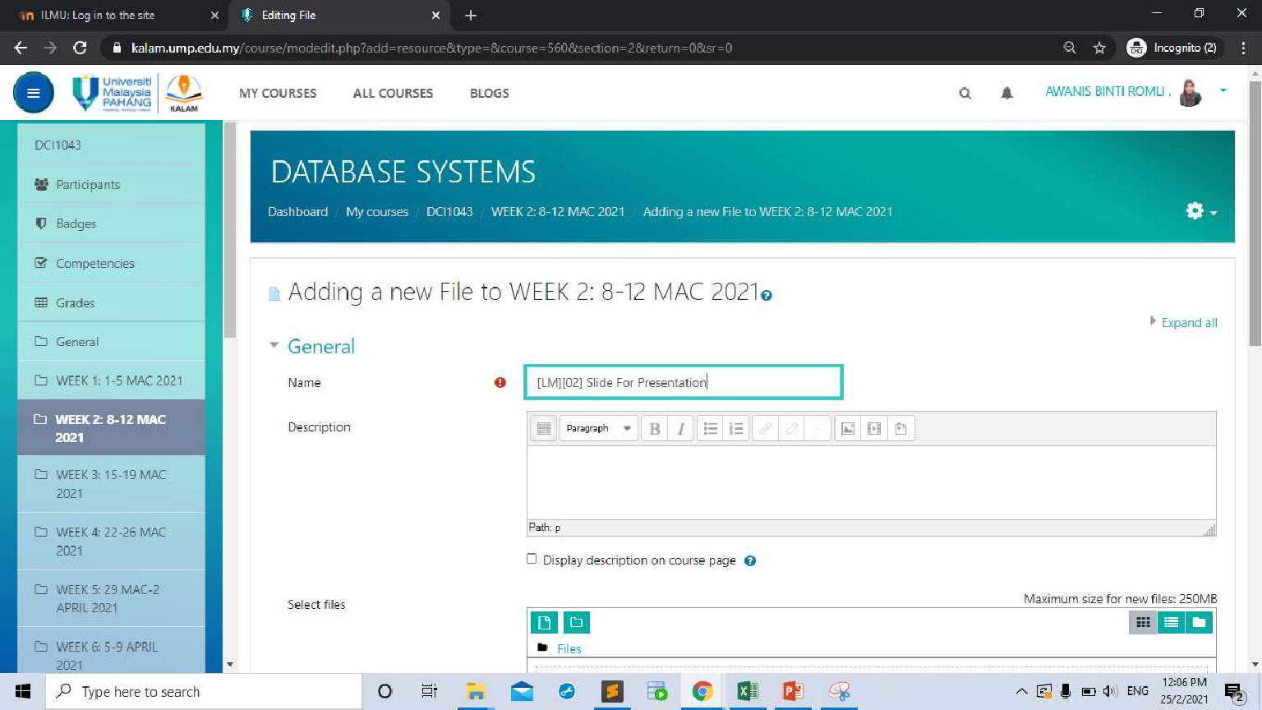
4. Create declaration of the PTG. For example [LM][02] which [LM] indicate Learning Material and
[02] indicate time which is 2Hour
and followed by material name
[LM][02] Chapter 2
[LM][02] Chapter 2

Slide 36
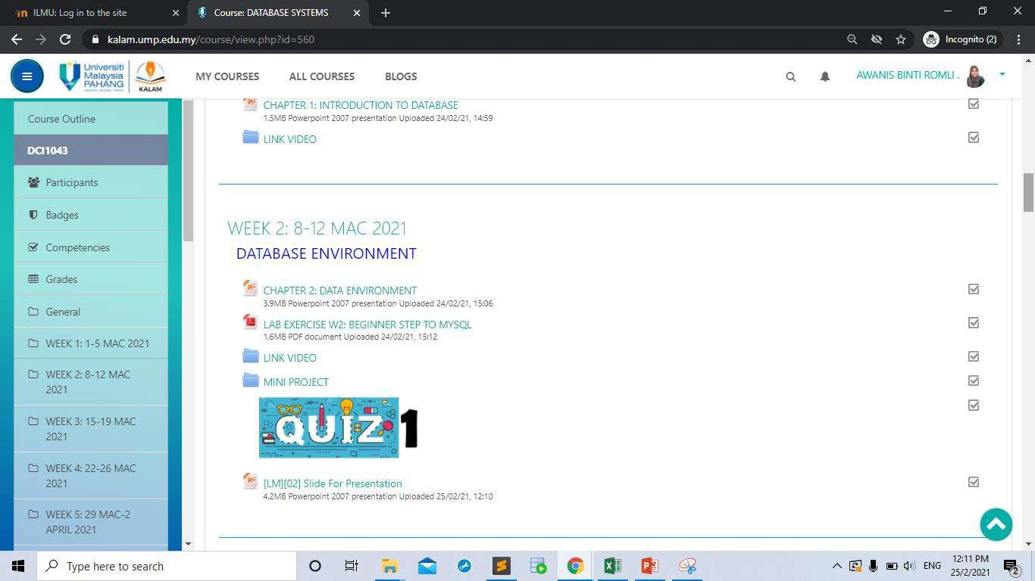
[LM][02] Chapter 2
5. It will display as been created.

Slide 37
SBL Declaration for Learning Activity (LA)
3. Select the activity or resource for example “Feedback”

Slide 38
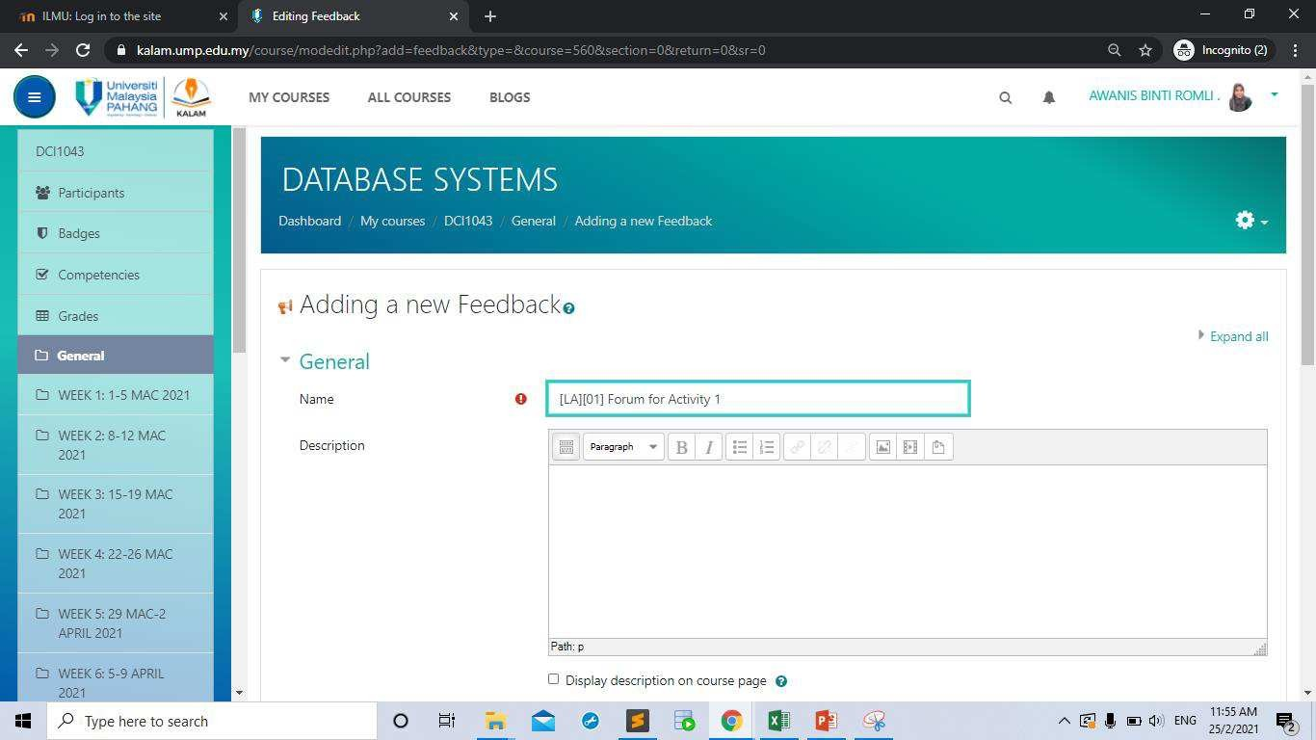
4. Create declaration of the PTG. For example [LA][01] which [LA] indicate Learning Activity and [01] indicate time which is 1Hour and followed by Activity name.
[LA][01] Forum Activity 1

Slide 39
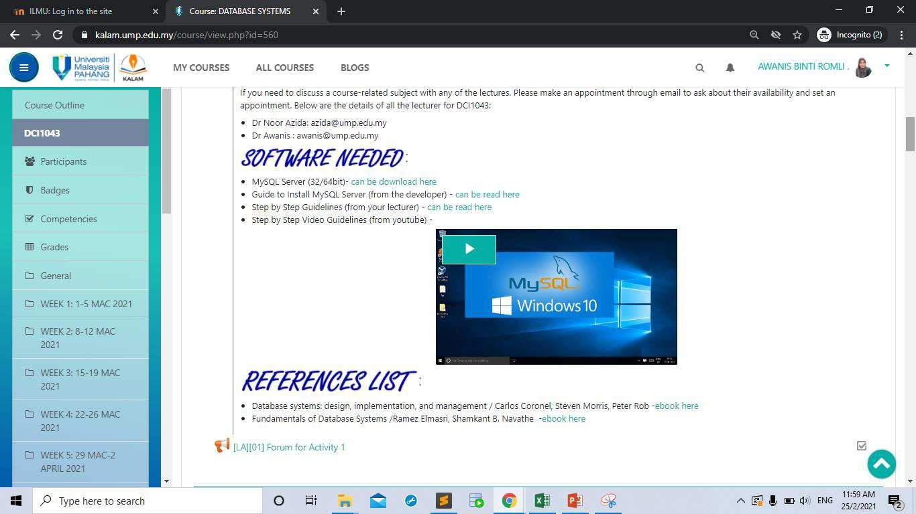
5. It will display as created.

Slide 40
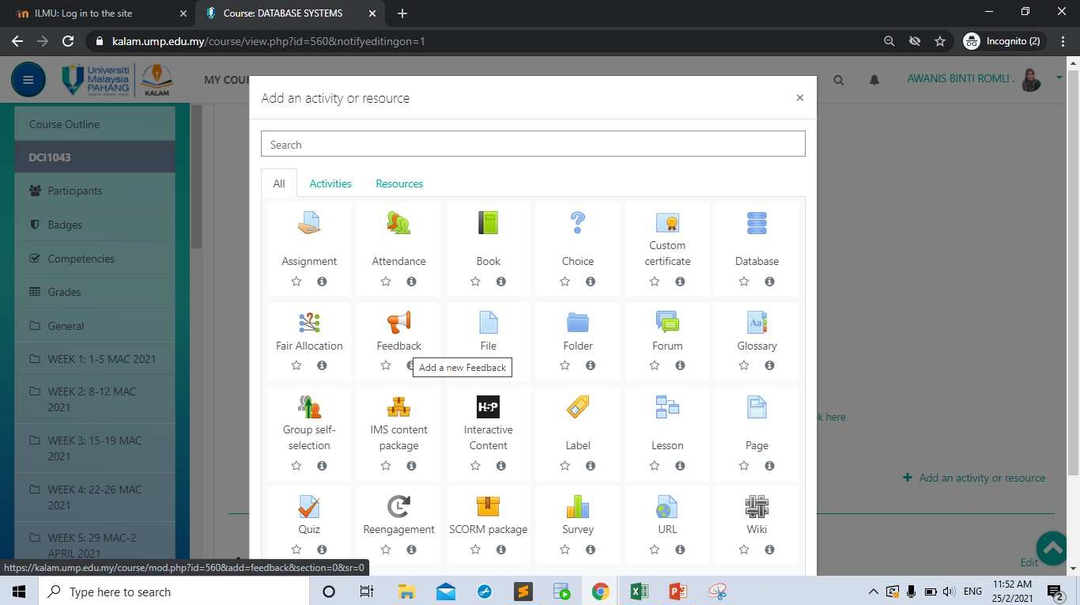
SBL Declaration for Learning Assessment (LS)
3. Select the activity or resource for example “Assignment”

Slide 41
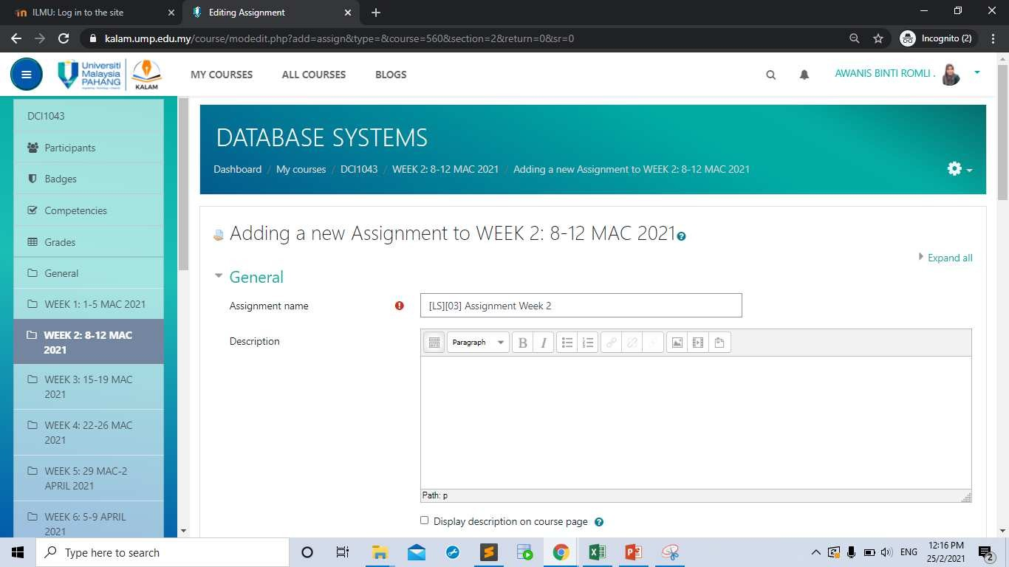
4. Create declaration of the PTG. For example [LS][03] which [LS] indicate Learning Assessment and [03] indicate time which is 3Hour and followed by assignment name
[LS][03] Assignment Week 2

Slide 42
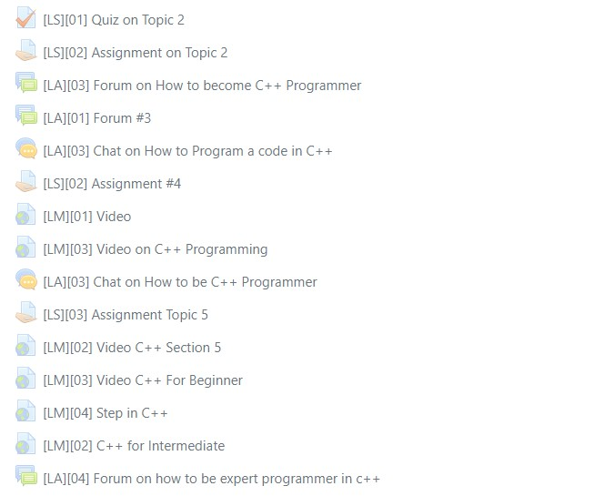
SBL Declaration Method in KALAM
[LS] - Declaration for Learning Assessment
[01] - Declaration for time
[LA] - Declaration for Learning Activity
[01] - Declaration for time
[LM] - Declaration for Learning Material
[03] - Declaration for time
Note:
For the SBL purpose – Learning material, learning activity and learning assessment in the KALAM need to be declared as [LA], [LM], and [LS] and followed by the time spent for each element.
42

Slide 43

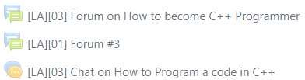

SBL Calculation in KALAM
Learning Material [LM] – Lecturer needs to key in code and hour. Example: [LM] [02]
Total LM = 01+03
= 04 hours
Learning Activities [LA] - Lecturer needs to key in code and hour. Example: [LA] [01]
Total LA = 03+01+03
= 07 hours
Learning Assessment [LS] - Lecturer needs to key in code and hour. Example: [LS] [01]
Total LS = 01+02
= 03 jam
43

Slide 44
SBL Reporting in KALAM

Slide 45
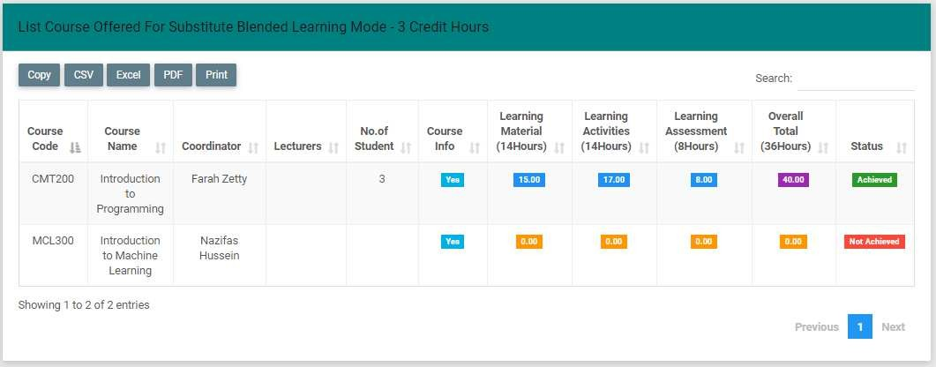
Example of reporting & calculation SBL
Label colour will turn to blue colour as the total hours [LM] >= 14h, [LA] >=14h and [LS] >= 8h
3
Status will change to “Achieved” as the overall total
achieved >= 36 hours
57

Slide 46

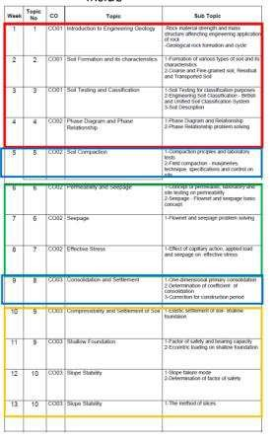



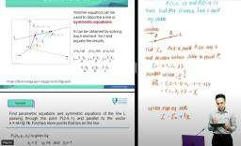
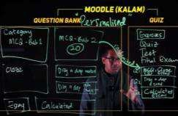
RUMUSAN
MODULAR
4 Weeks Modular
+
4 Weeks PTG
4 Weeks Modular
4 Weeks PTG

Slide 47
Terima Kasih

